Slide 1
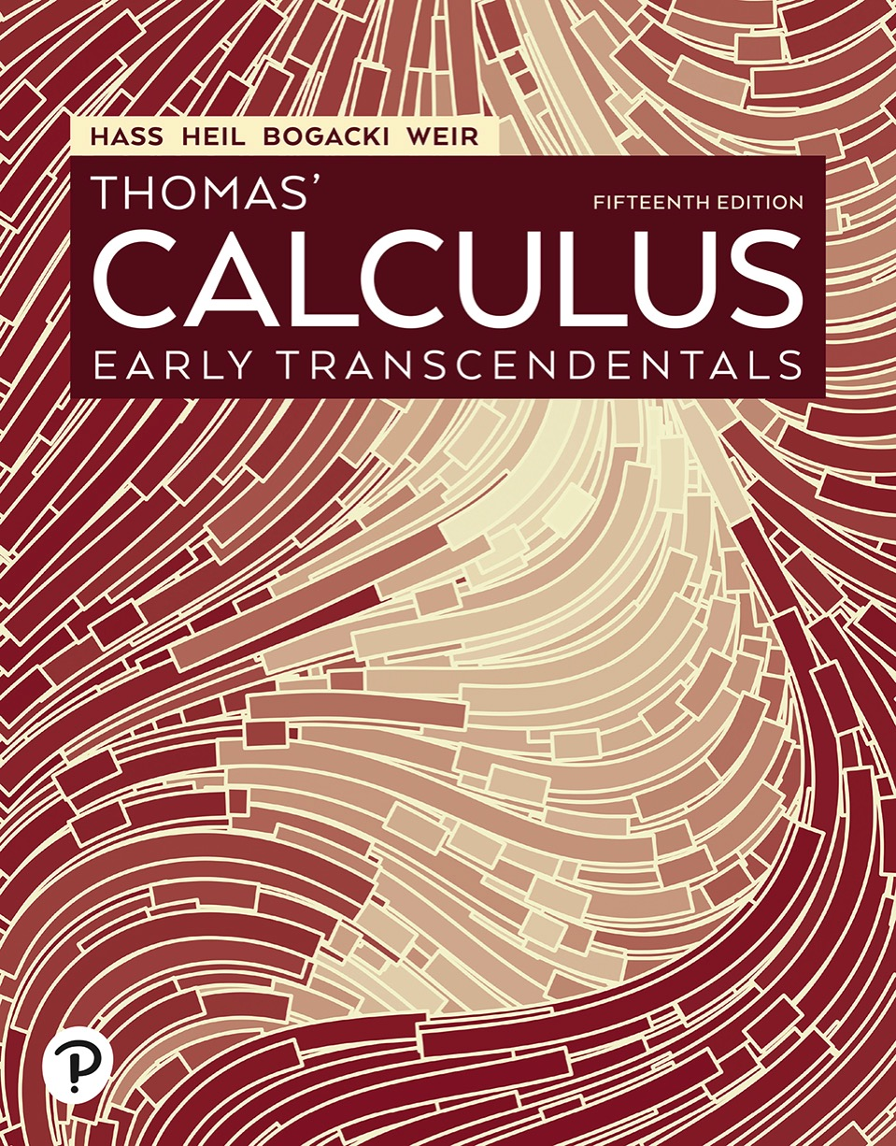

Thomas’ Calculus: Early Transcendentals
Fifteenth Edition
Chapter 14
Partial Derivatives
Copyright © 2023, 2018, 2014 Pearson Education, Inc. All Rights Reserved
Notes:
If this PowerPoint presentation contains mathematical equations, you may need to check that your computer has the following installed:
1) MathType Plugin
2) Math Player (free versions available)
3) NVDA Reader (free versions available)

Slide 2
Section 14.4 The Chain Rule

Slide 3
Functions of Two Variables (1 of 5)
Theorem—Chain Rule For Functions of One Independent Variable and Two Intermediate Variables
If
is differentiable and if
are differentiable functions of t, then the composition
is a differentiable function of t and
or

Slide 4
Functions of Two Variables (2 of 5)
Often we write
for the partial derivative
so we can rewrite the Chain Rule in the form

Slide 5
Functions of Two Variables (3 of 5)
Example: Use the Chain Rule to find the derivative of
with respect to t along the path
What is the derivative’s value at
Solution: We apply the Chain Rule to find
as follows:

Slide 6
Functions of Two Variables (4 of 5)
Solution (continued):
In this example, we can check the result with a more direct calculation. As a function of t,

Slide 7
Functions of Two Variables (5 of 5)
Solution (concluded):
so
In either case, at the given value of t,

Slide 8
Functions of Three Variables (1 of 6)
Theorem—Chain Rule for Functions of One Independent Variable and Three Intermediate Variables
If
is differentiable and x, y, and z are
differentiable functions of t, then w is a differentiable function of t and

Slide 9
Functions of Three Variables (2 of 6)
Example: Find
if
In this example the values of
are changing along the
path of a helix (Section 13.1) as t changes. What is the derivative’s value at t = 0?
Solution: Using the Chain Rule for three intermediate variables, we have

Slide 10
Functions of Three Variables (3 of 6)
Solution (concluded):
so

Slide 11
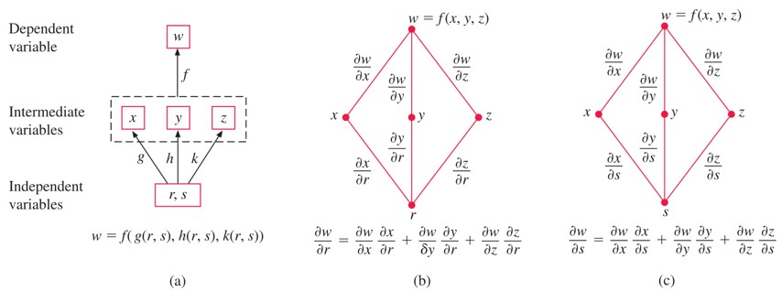
Functions Defined on Surfaces (1 of 9)
Composite function and dependency diagrams.
Notes:
Three illustrations are as follows. The first illustration, a, depicts the variables in blocks with labels. The block labeled, independent variables, has the variables r and s. The three upward arrows labeled, g, h, and k, from this block point toward three blocks with the variables, x, y, and z, respectively. The variables, x, y, and z, are labeled, intermediate variables. A rectangular box drawn using dashed lines covers the three blocks with the variables, x, y, and z. An upward arrow labeled, f, starting from the rectangular box points toward a block with the variable, w. The variable, w, is labeled, dependent variable. An equation below the illustration reads, w = f left parenthesis g left parenthesis r, s right parenthesis, h left parenthesis r, s right parenthesis, k left parenthesis r, s right parenthesis right parenthesis. The second illustration, b, depicts a polygon. The four vertices of the polygon are w = f of x, y, and z, z, r, and x. The diagonal connects the vertices, w and r. The midpoint of the diagonal is labeled, y. The distance between w = f of x, y, and z and z is labeled, partial derivative of w with respect to z. The distance between z and r is labeled, partial derivative of z with respect to r. The distance between r and x is labeled, partial derivative of x with respect to r. The distance between x and w is labeled, partial derivative of w with respect to x. The distance between w and y is labeled, partial derivative of w with respect to y. The distance between y and r is labeled, partial derivative of y with respect to r. An equation below the polygon reads, partial derivative of w with respect to r = partial derivative of w with respect to x times partial derivative of x with respect to r + partial derivative of w with respect to y times partial derivative of y with respect to r + partial derivative of w with respect to z times partial derivative of z with respect to r. The third illustration, c, is a polygon. The four vertices of the polygon are w = f of x, y, and z, z, s, and x. The diagonal connects the vertices, w and s. The midpoint of the diagonal is labeled, y. The distance between w = f of x, y, and z and z is labeled, partial derivative of w with respect to z. The distance between z and s is labeled, partial derivative of z with respect to s. The distance between s and x is labeled, partial derivative of x with respect to s. The distance between x and w is labeled, partial derivative of w with respect to x. The distance between w and y is labeled, partial derivative of w with respect to y. The distance between y and s is labeled, partial derivative of y with respect to s. An equation below the polygon reads, partial derivative of w with respect to s = partial derivative of w with respect to x times partial derivative of x with respect to s + partial derivative of w with respect to y times partial derivative of y with respect to s + partial derivative of w with respect to z times partial derivative of z with respect to s.

Slide 12
Functions Defined on Surfaces (2 of 9)
Theorem—Chain Rule for Two Independent Variables and Three Intermediate Variables
Suppose that
and
If all four functions are differentiable,
then w has partial derivatives with respect to r and s, given by the formulas

Slide 13
Functions Defined on Surfaces (3 of 9)
Example: Express
in terms of r and s if
Solution: Using the formulas in the previous Theorem, we find

Slide 14
Functions Defined on Surfaces (4 of 9)
Solution (concluded):

Slide 15
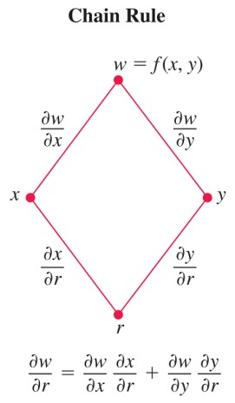
Functions Defined on Surfaces (5 of 9)
Dependency diagram for the equation
Notes:
The distance between w = f of x and y and y is labeled, partial derivative of w with respect to y. The distance between y and r is labeled, partial derivative of y with respect to r. The distance between r and x is labeled, partial derivative of x with respect to r. The distance between x and w is labeled, partial derivative of w with respect to x. An equation below the polygon reads, partial derivative of w with respect to r = partial derivative of w with respect to x times partial derivative of x with respect to r + partial derivative of w with respect to y times partial derivative of y with respect to r.

Slide 16
Functions Defined on Surfaces (6 of 9)
If
then

Slide 17
Functions Defined on Surfaces (7 of 9)
Example: Express
in terms of r and s if
Solution: The preceding discussion gives the following.

Slide 18
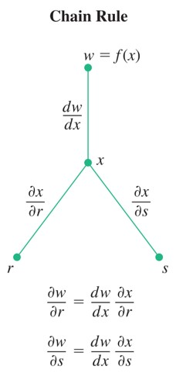
Functions Defined on Surfaces (8 of 9)
Dependency diagram for differentiating f as a composite function of r and s with one intermediate variable.
Notes:
The connection resembles an inverted y shape. The distance between w and x is labeled, derivative of w with respect to x. The distance between x and s is labeled, partial derivative of x with respect to s. The distance between x and r is labeled, partial derivative of x with respect to r. Two equations below this illustration are read as follows. Equation 1. Partial derivative of w with respect to r = derivative of w with respect to x times partial derivative of x with respect to r. Equation 2. Partial derivative of w with respect to s = derivative of w with respect to x + partial derivative of x with respect to s.

Slide 19
Functions Defined on Surfaces (9 of 9)
If
then

Slide 20
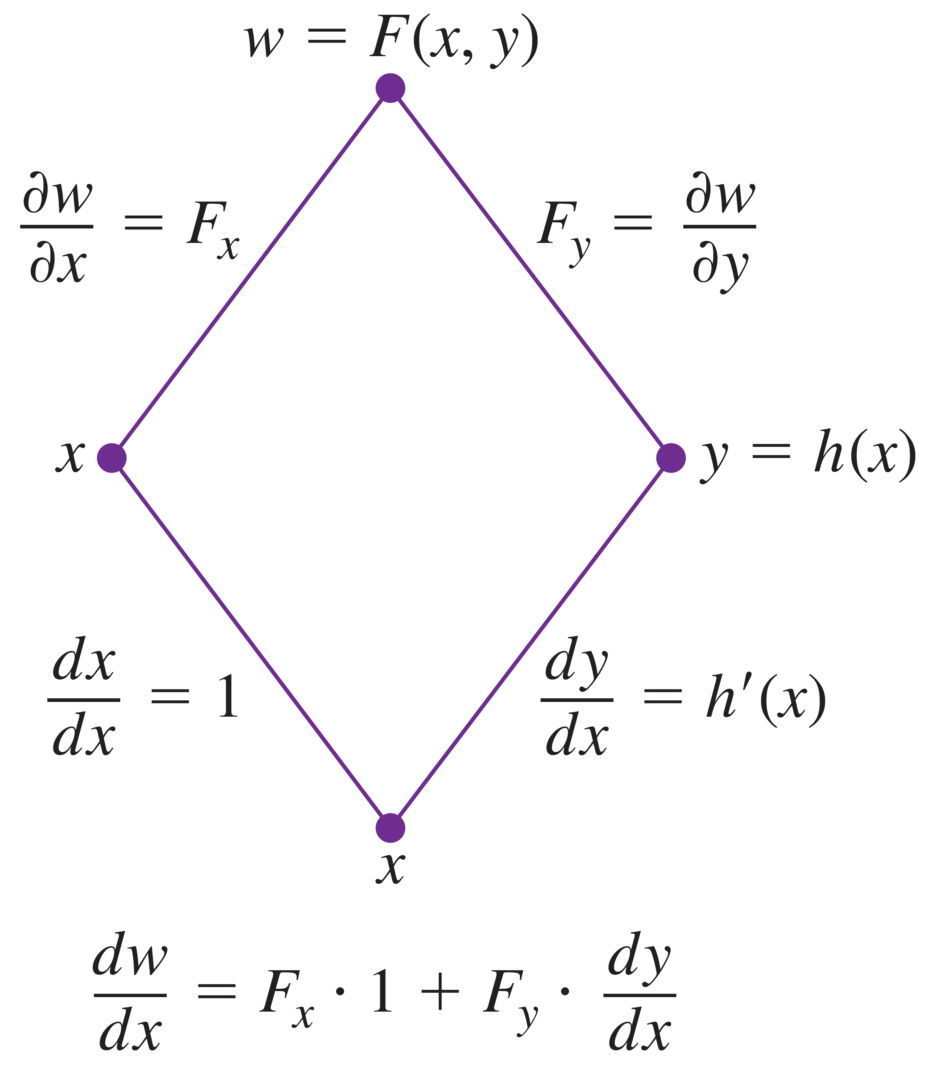
Implicit Differentiation Revisited (1 of 6)
Dependency diagram for
differentiating
with respect to x. Setting
leads to a simple
computational formula for implicit differentiation.
Notes:
The four vertices of the polygon are w = F of x and y, y = h of x, and x, x. The distance between w and y is labeled, F sub y = partial derivative of w with respect to y. The distance between y and x is labeled, derivative of y with respect to x = h prime of x. The distance between x and x is labeled, derivative of x with respect to x = 1. The distance between x and w is labeled, partial derivative of w with respect to x = F sub x. An equation below the polygon reads, derivative of w with respect to x = F sub x times 1 + F sub y times derivative of y with respect to x.

Slide 21
Implicit Differentiation Revisited (2 of 6)
Theorem—A Formula for Implicit Differentiation
Suppose that
is differentiable and that the
equation
defines y as a differentiable
function of x. Then at any point where

Slide 22
Implicit Differentiation Revisited (3 of 6)
Example: Use the previous Theorem to find
Solution: Take
Then
This calculation is significantly shorter than a single-variable calculation using implicit differentiation.

Slide 23
Implicit Differentiation Revisited (4 of 6)

Slide 24
Implicit Differentiation Revisited (5 of 6)
Example: Find
at (0, 0, 0) if
Solution: Let
Then
Since
and all first partial
derivatives are continuous,
defines z as a
differentiable function of x and y near the point (0, 0, 0).

Slide 25
Implicit Differentiation Revisited (6 of 6)
Solution (concluded):
At (0, 0, 0) we find

Slide 26
Functions of Many Variables
In general, suppose that
is a
differentiable function of the intermediate variables
(a finite set) and the
differentiable functions of the independent variables
(another finite set). Then w is a
differentiable function of the variables p through t, and the partial derivatives of w with respect to these variables are given by equations of the form

Slide 27
Section 14.5 Directional Derivatives and Gradient Vectors

Slide 28
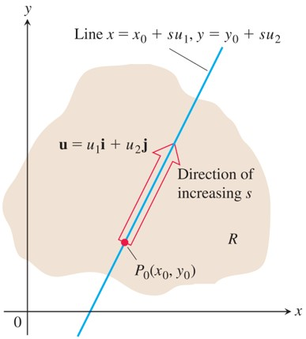
Directional Derivatives in the Plane (1 of 5)
The rate of change of f in the direction of u at a point
is the rate at which f
changes along this line at
Notes:
The rising line is labeled, line x = x sub 0 + s u sub 1, y = y sub 0 + s u sub 2. An upward arrow starts from point P sub 0 left parenthesis x sub 0, y sub 0 right parenthesis, which lies on the rising line. The arrow is labeled, u = u sub 1 i + u sub 2 j. The text indicating the arrow reads, direction of increasing s.

Slide 29
Directional Derivatives in the Plane (2 of 5)
Definition: The derivative of f at
in the direction of the unit vector
is the number
provided the limit exists.

Slide 30
Directional Derivatives in the Plane (3 of 5)
Example: Using the definition, find the derivative of
at
in the direction of the unit vector
Solution: Applying the definition, we obtain

Slide 31
Directional Derivatives in the Plane (4 of 5)
Solution (continued):

Slide 32
Directional Derivatives in the Plane (5 of 5)
Solution (concluded):
The rate of change of
in the direction u is

Slide 33
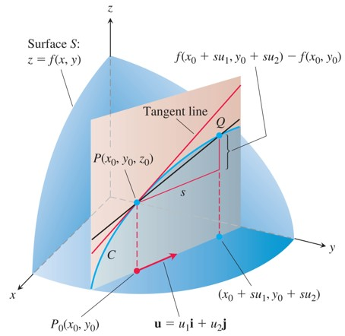
Interpretation of the Directional Derivative
The slope of the trace
curve C at
slope (P Q); this is the directional derivative
Notes:
The rectangular sheet intersects the surface, S, for z = f of x and y. The concave down increasing curve C on the sheet passes through point, P, and point, Q, placed below the tangent line. The tangent line at P cuts the positive y axis. The secant line passes through P and Q. A line joins P and Q by a horizontal distance, s, followed by a vertical distance, f, left parenthesis x sub 0 + s u sub 1, y sub 0 + s u sub 2 right parenthesis minus f of x sub 0 and y sub 0. Point, Q, is vertically projected downward to a point left parenthesis x sub 0 + s u sub 1, y sub 0 + s u sub 2 right parenthesis in the x y plane. Point, P, is vertically projected downward to point P sub 0 left parenthesis x sub 0, y sub 0 right parenthesis. A vector, u = u sub 1 i + u sub 2 j, is pointing from P sub 0 to left parenthesis x sub 0 + s u sub 1, y sub 0 + s u sub 2 right parenthesis.

Slide 34
Calculation and Gradients (1 of 12)
Definition: The gradient vector (or gradient) of
is the vector
The value of the gradient vector obtained by evaluating the partial derivatives at a point
is written

Slide 35
Calculation and Gradients (2 of 12)
Theorem—The Directional Derivative Is a Dot Product
If
is differentiable in an open region containing
then
the dot product of the gradient
with the
vector u. In brief,

Slide 36
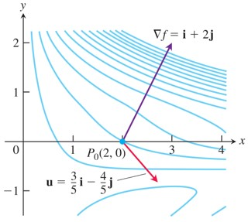
Calculation and Gradients (3 of 12)
Picture
as a vector in the domain of f. The figure shows
a number of level curves of f. The rate at which f changes at
(2, 0) in the direction u is
which is the
component of
in the direction of unit vector u.
Notes:
Two vector gradients, f and u, originate from point P sub 0 (2, 0). Gradient f = i + 2 j is pointing upward toward the first quadrant, and u = 3 fifths i minus 4 fifths j is pointing toward the fourth quadrant. A curve falls from (0.1, 2.2) and passes through (2, 0) toward the fourth quadrant. Series of curves are drawn above and below this curve.

Slide 37
Calculation and Gradients (4 of 12)
Example: Find the derivative of
at the point (2, 0) in the direction of
Solution: Recall that the direction of a vector v is the unit vector obtained by dividing v by its length:
The partial derivatives of f are everywhere continuous and at (2, 0) are given by

Slide 38
Calculation and Gradients (5 of 12)
Solution (continued):
The gradient of f at (2, 0) is
The derivative of f at (2, 0) in the direction of v is therefore

Slide 39
Calculation and Gradients (6 of 12)
Solution (concluded):

Slide 40
Calculation and Gradients (7 of 12)
Properties of the Directional Derivative
1. The function f increases most rapidly when
which means that
and u is the direction of
That is, at each point P in its domain, f increases most
rapidly in the direction of the gradient vector
at P.
The derivative in this direction is

Slide 41
Calculation and Gradients (8 of 12)
2. Similarly, f decreases most rapidly in the direction of
The derivative in this direction is
3. Any direction u orthogonal to a gradient
is a direction of zero change in f because
and

Slide 42
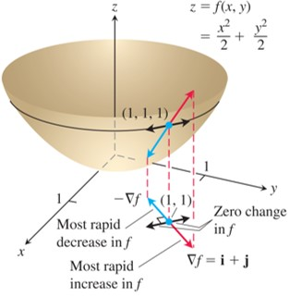
Calculation and Gradients (9 of 12)
The direction in which
increases most rapidly at
(1, 1) is the direction of
It corresponds to
the direction of steepest ascent on the surface at (1, 1, 1).
Notes:
with a level curve passes through (1, 1, 1). Two vectors are passing from point (1, 1, 1). Point (1, 1, 1) is projected below to (1, 1) in the x y plane. A vector gradient, f = i + j, is pointing away from point (1, 1, 1) in y z plane and projected below the image from point (1, 1) that is labeled, most rapid increase in f. Another negative vector gradient, f, is pointing toward the origin and also projected at point (1, 1) that is labeled, most rapid decrease in f. Two opposite arrows projected in an x y plane at point (1, 1) is labeled, zero change in f.

Slide 43
Calculation and Gradients (10 of 12)
Example: Find the directions in which
(a) increases most rapidly at the point (1, 1), and
(b) decreases most rapidly at (1, 1).
(c) What are the directions of zero change in f at (1, 1)?
Solution:
(a) The function increases most rapidly in the direction of
at (1, 1). The gradient there is

Slide 44
Calculation and Gradients (11 of 12)
Solution (continued):
Its direction is
(b) The function decreases most rapidly in the direction of
at (1, 1), which is

Slide 45
Calculation and Gradients (12 of 12)
Solution (concluded):
(c) The directions of zero change at (1, 1) are the
directions orthogonal to

Slide 46
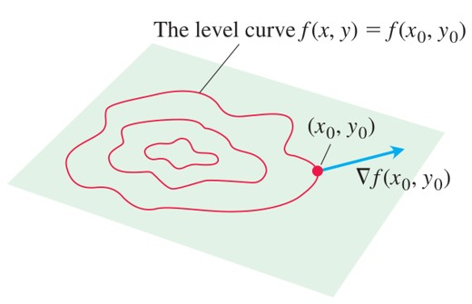
Gradients and Tangents to Level Curves (1 of 8)
The gradient of a differentiable function of two variables at a point is always normal to the function’s level curve through that point.
Notes:
The outermost level curve is labeled, the level curve f of x and y = f of x sub 0 and y sub 0. Point (x sub 0, y sub 0) is marked on the outermost level curve. A vector gradient, f left parenthesis x sub 0, y sub 0 right parenthesis, starts from (x sub 0, y sub 0) and points outward to the right.

Slide 47
Gradients and Tangents to Level Curves (2 of 8)
At every point
in the domain of a
differentiable function
the gradient of
f is normal to the level curve through
(See Figure above).

Slide 48
Gradients and Tangents to Level Curves (3 of 8)
Tangent Line to a Level Curve

Slide 49
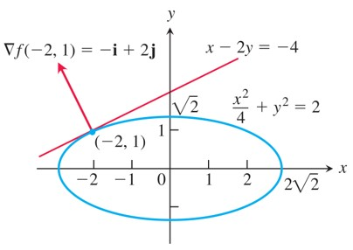
Gradients and Tangents to Level Curves (4 of 8)
We can find the tangent to the ellipse
by treating the ellipse as a level curve of the function
Notes:
The tangent line to the ellipse, x minus 2 y = negative 4, passes through (negative 2, 1). A vector gradient, f left parenthesis negative 2, 1 right parenthesis = negative i + 2 j, starts from (negative 2, 1) and points toward the second quadrant.

Slide 50
Gradients and Tangents to Level Curves (5 of 8)
Example: Find an equation for the tangent to the ellipse
at the point
Solution: The ellipse is a level curve of the function
The gradient of f at

Slide 51
Gradients and Tangents to Level Curves (6 of 8)
Solution (concluded):
Because this gradient vector is nonzero, the tangent
to the ellipse at
is the line

Slide 52
Gradients and Tangents to Level Curves (7 of 8)
Algebra Rules for Gradients
1. Sum Rule:
2. Difference Rule:
3. Constant Multiple Rule:
(any number k)
4. Product Rule:
5. Quotient Rule:

Slide 53
Gradients and Tangents to Level Curves (8 of 8)
Example: We illustrate two of the rules with
We have
1.
2.
and
We have therefore verified for this example that

Slide 54
Functions of Three Variables (4 of 6)
Example:
(a) Find the derivative of
at
in the direction of
(b) In what directions does f change most rapidly at
and what are the rates of change in these directions?
Solution:
(a) The direction of v is obtained by dividing v by its length:

Slide 55
Functions of Three Variables (5 of 6)
Solution (continued):
The partial derivatives of f at
are
The gradient of f at
is
The derivative of f at
in the direction of v is therefore

Slide 56
Functions of Three Variables (6 of 6)
Solution (concluded):
(b) The function increases most rapidly in the direction of
and decreases most rapidly in the
direction of
The rates of change in the directions
are, respectively,

Slide 57
Functions of More Than Three Variables (1 of 6)
The gradient of a differentiable function of n variables
The directional derivative of f in the direction of the unit vector u is

Slide 58
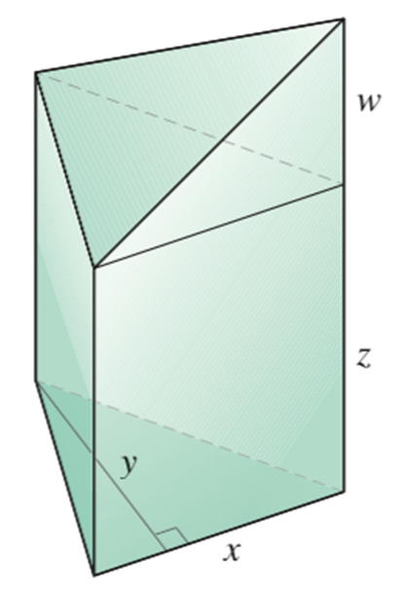
Functions of More Than Three Variables (2 of 6)
Example:
The volume of the solid shown in the figure consisting of a tetrahedron on top of a triangular prism is given by
(a) Calculate the derivative of
at the point
in the direction of
(b) What is the geometric significance of the value obtained in part (a)?

Slide 59
Functions of More Than Three Variables (3 of 6)
Solution:
(a) The direction of v is the unit vector
Notes:
u = start fraction 1 over absolute value of v end fraction v. = start fraction 1 over square root of start expression 1 squared + left parenthesis negative 1 right parenthesis squared + left parenthesis negative 1 right parenthesis squared + 1 squared end fraction left brace 1, negative 1, negative 1, 1 right brace = 1 half left brace 1, negative 1, negative 1, 1 right brace = left brace 1 half, negative 1 half, negative 1 half, 1 half right brace

Slide 60
Functions of More Than Three Variables (4 of 6)
Solution (continued):
The four partial derivatives of f at the point
are

Slide 61
Functions of More Than Three Variables (5 of 6)
Solution (continued):
The gradient of f at the point
The derivative of f at (6, 5, 8, 4) in the direction of v is
Notes:
D sub u f, at P sub 0 = delta f, at P sub 0, times u = left brace 70 thirds, 28, 15, 5 right brace times left brace 1 half, negative 1 half, negative 1 half, 1 half right brace = 70 thirds times 1 half + 28 times negative 1 half + 15 times negative 1 half + 5 times 1 half = negative 22 thirds

Slide 62
Functions of More Than Three Variables (6 of 6)
Solution (concluded):
(b) Geometrically, this means that if the dimensions are x = 6, y = 5, z = 8, and w = 4, and the dimensions are changed by moving at unit speed so that x and w increase at the same rate while both y and z decrease at that rate, then the volume of the solid decreases at
the rate of

Slide 63
The Chain Rule for Paths
The Derivative Along a Path

Slide 64

Copyright
This work is protected by United States copyright laws and is provided solely for the use of instructors in teaching their courses and assessing student learning. Dissemination or sale of any part of this work (including on the World Wide Web) will destroy the integrity of the work and is not permitted. The work and materials from it should never be made available to students except by instructors using the accompanying text in their classes. All recipients of this work are expected to abide by these restrictions and to honor the intended pedagogical purposes and the needs of other instructors who rely on these materials.

